Slide 1
Capstone Project
Play store app review analysis

Slide 2
Content
a
Analysis based on :
Category
App
Installs
Ratings
Reviews
Size
Type
Content rating
Sentiments

Slide 3
Problem statement
The Play Store apps data has enormous potential to drive app-making businesses to success. Actionable insights can be drawn for developers to work on and capture the Android market.
Each app (row) has values for category, rating, size, and more. Another dataset contains customer reviews of the android apps.
Explore and analyze the data to discover key factors responsible for app engagement and success.

Slide 4
Data summary
The dataset spans over nine years :
2010,2011,2012,2013,2014,2015,2016,2017,2018.
Important features:
1] App
2]Category
3]Content
4]Rating
5]Type
6]Reviews
7]Last update
8]Rating

Slide 5
Refinement of dataset
Refining a dataset is the most crucial stage in data analysis. Refinement of a dataset refers to the process of cleaning data and handling the null/ missing data. If your dataset is not properly refined then you may not achieve the optimum results from the dataset. Unrefined data were more prone to creating errors in the results. Sometimes you get an error or gets the wrong results.
Refine the dataset:
Removing Duplicate Apps
Removing 19.0 from the column rating
Removing 1.9 from the column category
Convert the dates in datetime.

Slide 6
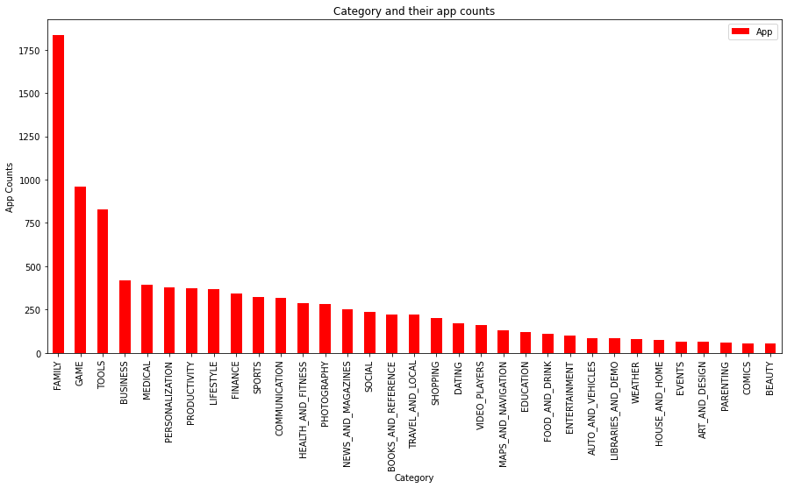
Category and their app counts

Slide 7
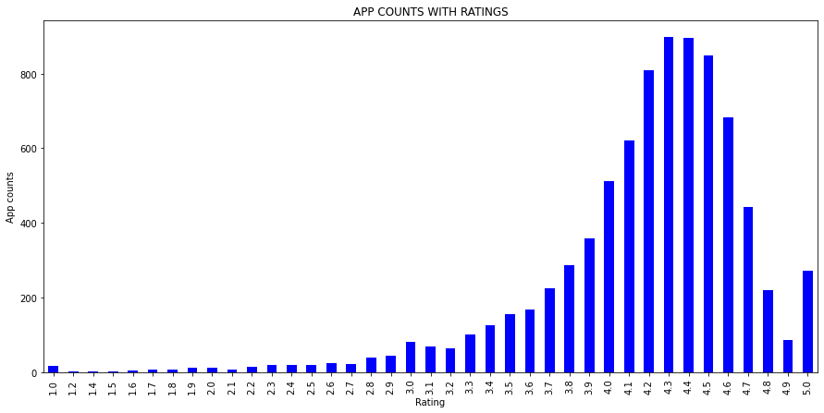
App counts with ratings

Slide 8
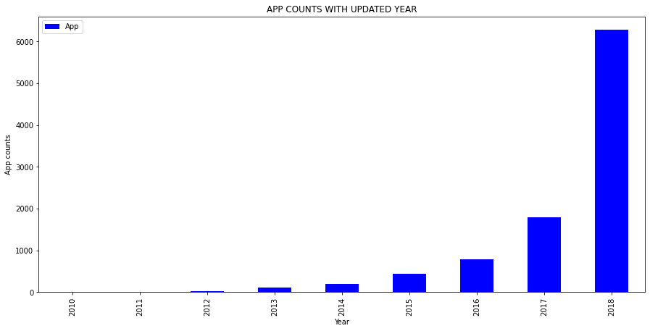
App counts with updated year

Slide 9
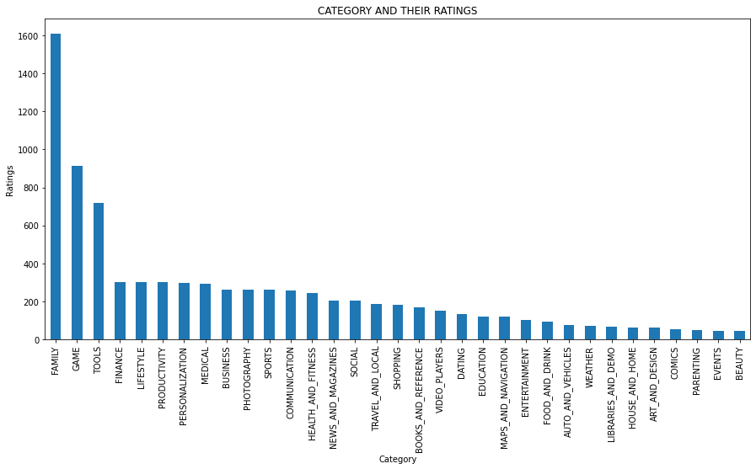
Category and their ratings

Slide 10
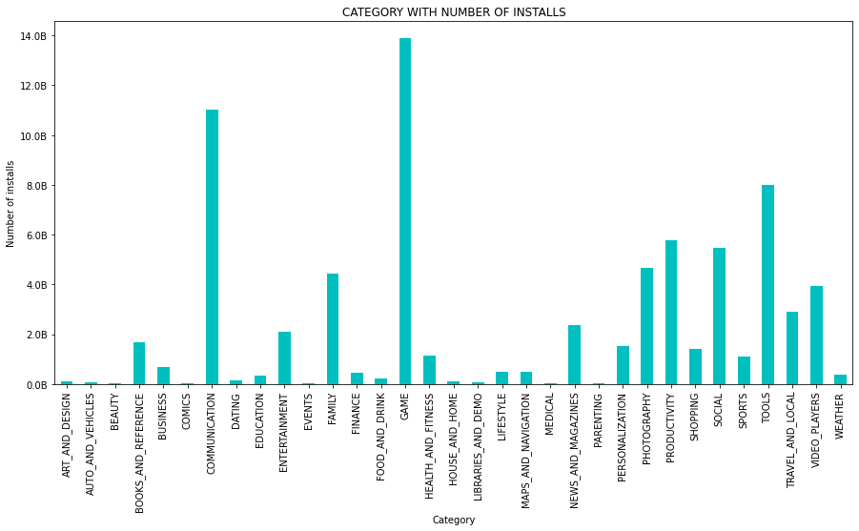
Category with number of installs

Slide 11
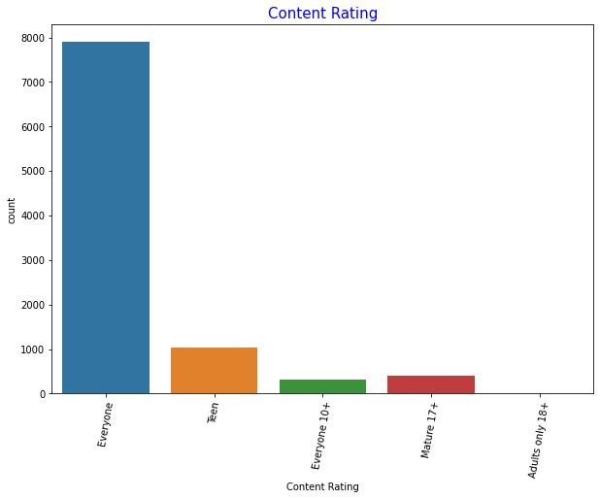
Content rating and their counts

Slide 12
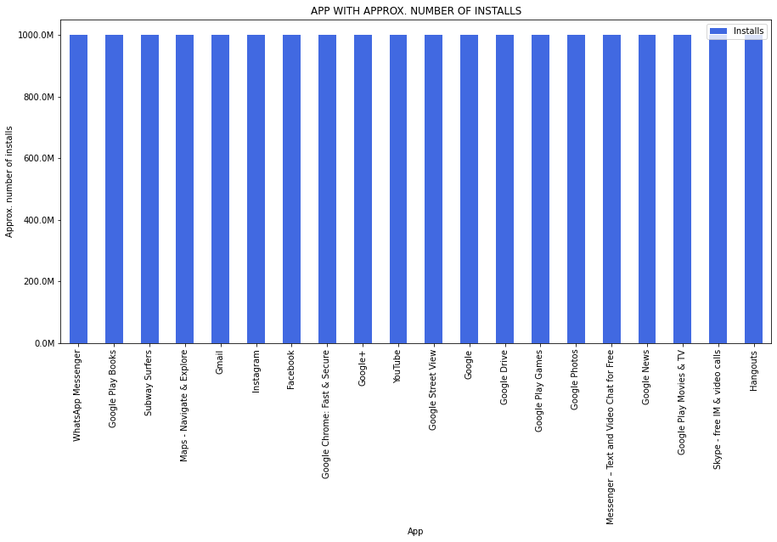
App with approx. installs

Slide 13
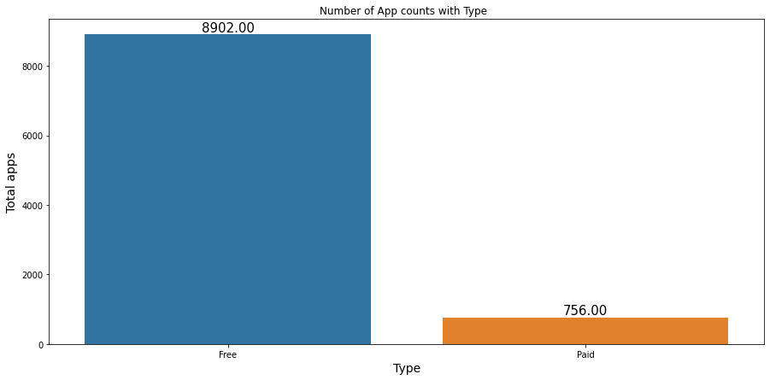
Number of app counts with type

Slide 14
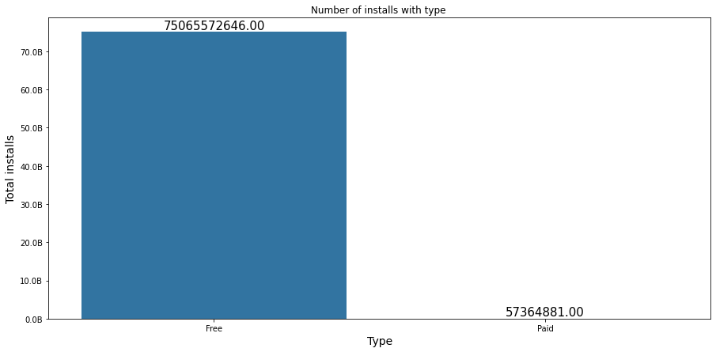
Number of installs with types

Slide 15
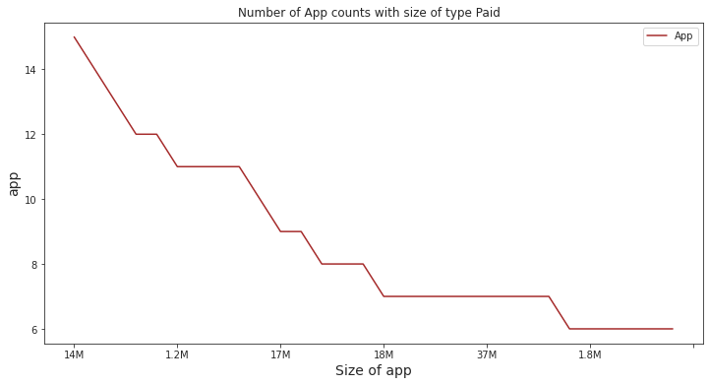
Number of app counts with size of type paid

Slide 16
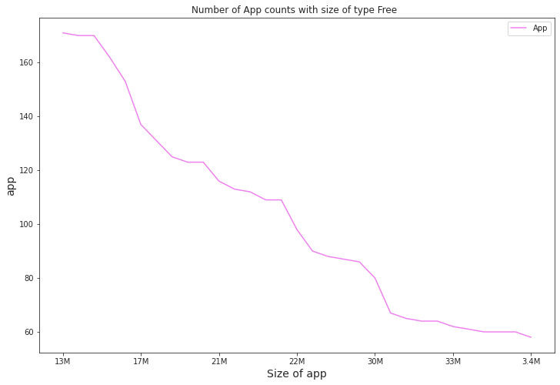
Number of app counts with size of type free

Slide 17
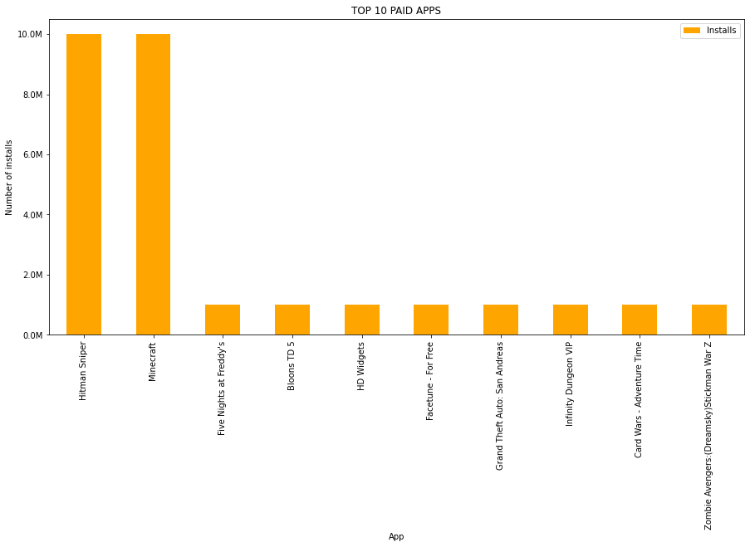
Top 10 paid apps

Slide 18
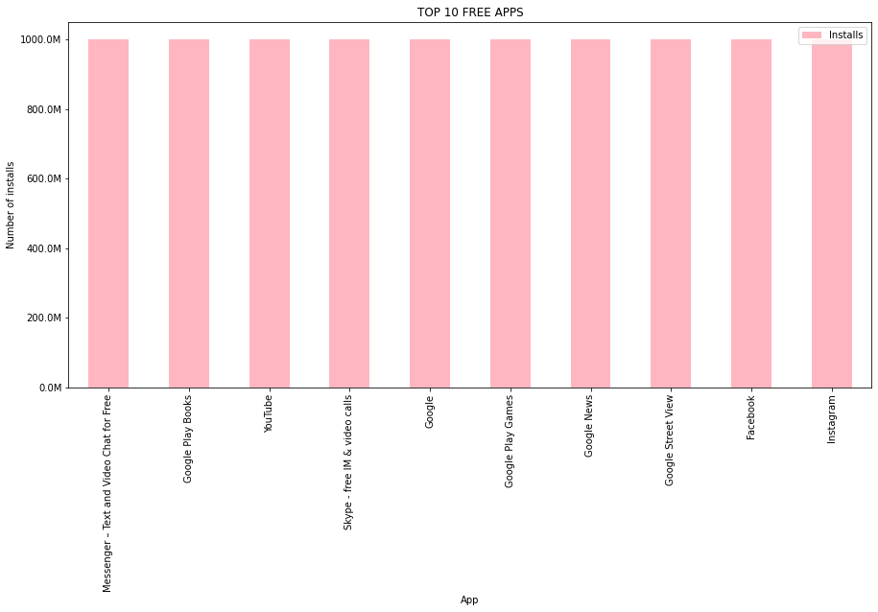
Top 10 free apps

Slide 19
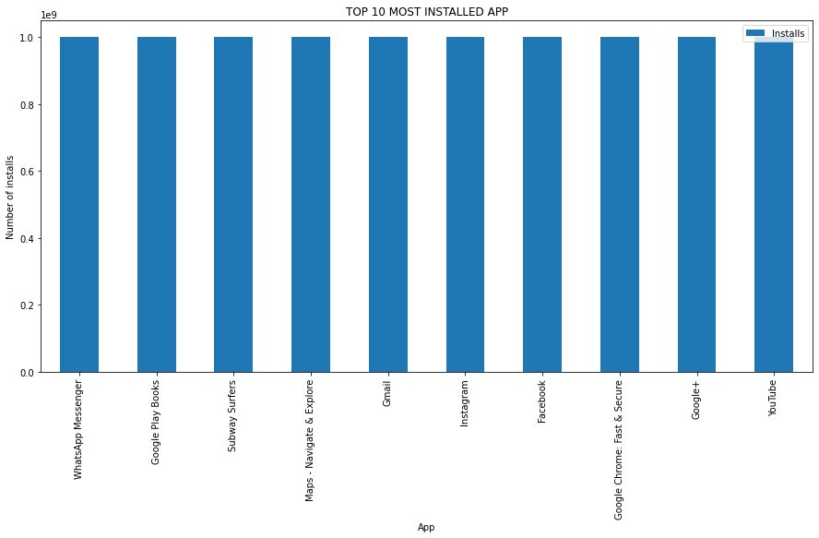
Top 10 most installed apps

Slide 20
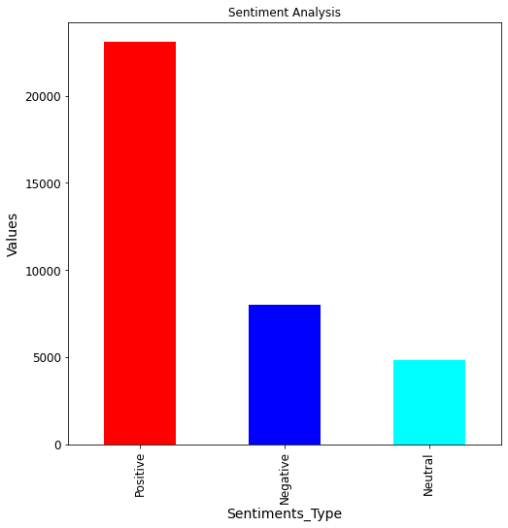
Sentiment Analysis

Slide 21
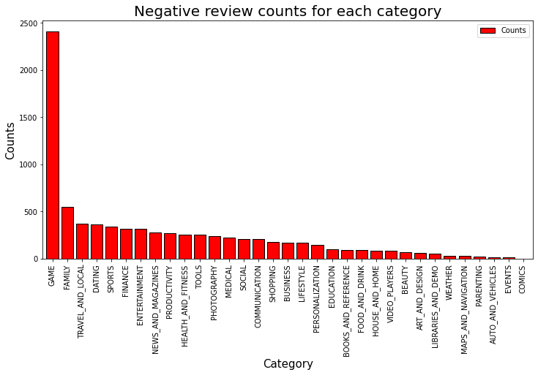
Negative review counts for each category

Slide 22
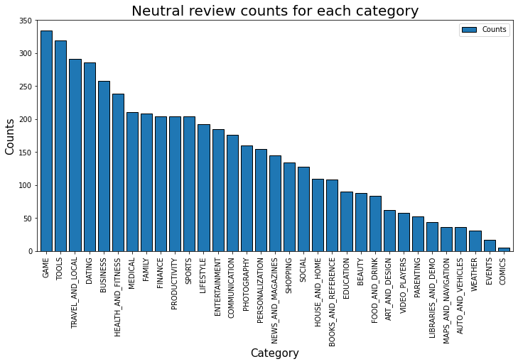
Neutral review counts for each category

Slide 23
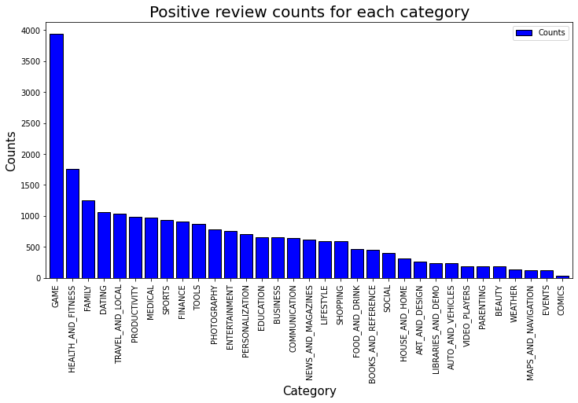
Positive review counts for each category

Slide 24
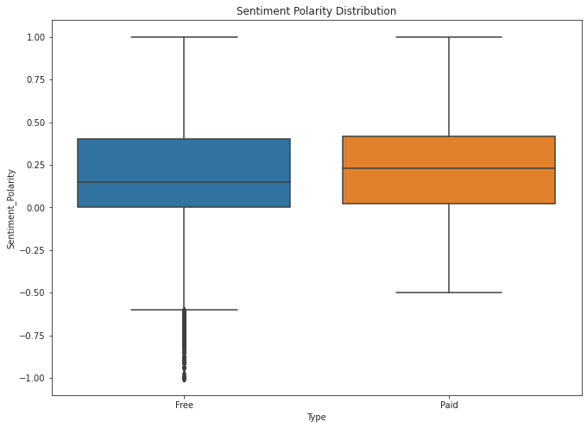
Sentiment polarity distribution

Slide 25
Challenges
~ The biggest challenge is to find the dataset is redundant or not. The size of data set is large so it takes lots of time to understand the data is redundant or not.
~ The sentiment polarity and sentiment subjective cause troubles for us. It is not easy how to use that data and which plot is suitable for that type of data.
~ The number of installs in the data is 10,000,000+, most of the apps has the same number. It is quite confusing for us to take which app or not.
~ In case of size, more than 1000 apps size varies with devices because of that we cannot consider these apps in some cases to refine our results.

Slide 26
Observation
~ There is a total of 1832 apps that are from the family category which is the most and after that game category is at second with 959 apps.
~ Here we can see 897 apps are having a 4.4 rating which is the most and after that, in the second place 895 apps are having a 4.3 rating, most apps are having 4.3 ratings. Most of the apps having ratings between 3.5 to 4.8.
~ Here we can see the family category is having the most ratings which are 1608 and second there is the game category with 912 ratings.
~ Here we can see the game category is having the most number of installs and after that communication category is having the second most number of installs.
~Out of 9659 apps 6284 receive updates in the year 2018.
~ Here we can see that the 7903 app belongs to the content rating everyone and 1036 is for teens. For Mature 17+ there are 393 apps. Only 3 apps fall under the 18+ category.
~ Here, we can see the apps with 1000000000+ installs.
~ Mostly the size of free app lying between 2.3M to 33M. There are 171 app of size 13M.
~ The size of paid apps lying between 1.2M to 33M.
~ Here we can see there is a total of 8902 apps that are free and 756 apps are paid.
~ Here we can see a total of 75065572646 free apps are installed and a total of 57364881 paid apps are installed.
~ Here we can see the paid apps with the number of installs.
~ We observe that 23073 peoples share the positive reviews and 8005 people share the negative reviews of the apps. And 5158 peoples share neutral reviews. And, 4851 peoples share neutral reviews for the apps.
~ Games category dominates in terms of positive review.
~ Comics category revises very less amount of reviews. It falls at last in terms of review. But, there is no negaitve reviews for comics.
~ The application Helix Jump has 209 positive reviews.
~ The application Calorie Counter - MyFitnessPal has 169 negative reviews.
~ From the Boxplot, we can analyze that the free app receives many harsh comments of very high negativity, which can be analyzed by the outliers on the negative y-axis. The paid apps also receive harsh comments but they are not extreme negative as free apps.
~ This may demonstrate something about application quality, i.e., paid applications being more excellent than free applications all things considered.

Slide 27
Conclusion
The major key factor responsible for engagement and success is the size of the app, category, content rating, type, reviews, and rating. As we observe in the above graphs, the family and games category dominates the app counts. Most of the apps belong to these two categories. Similarly, the maximum app rating lying between 3.4 to 4.8. Also, the apps that are of type free are more popular than paid apps. Updates play an important role in the success of an app because the update provides the latest features and removes the bugs. Those apps whose sizes are less can be used on all devices. How many people installed the app is also a major factor because if more people install the app then it means more people give ratings and reviews for the apps. Games category app receives the highest positive reviews. But, the quality of paid apps is better than free. For example, the app Helix Jump receives the highest positive review having a rating of 4.2 and of type free and it is installed on more than 100000000 devices.
Some factor varies from person to person such as those people who want quality in apps they opt for paid apps. In my opinion, the size of the app should be less and if the app is paid then the price of the app is economical. It would be better if the app is free. The app is available for all age groups. Nowadays people mostly used games and social apps.

Slide 28
Q&A

Slide 29
THANK YOU !

